Slide 1

DriverPass System Analysis
Shayne Rushton
Notes:
[No speaker notes required for this slide.]
<number>

Slide 2

Allow a large number of users at once
Fast app loading and navigation with less than 4 second lag
Allow appointment scheduling online
User Interface with test progress, Instructor information, notes and special instructions
System Requirements
Notes:
DriverPass wants to reach a larger audience and fill the gap left in the driving test system. By offering a fast application that allows students to schedule time with a quality instructor and keep track of their progress from anywhere, they can meet their goal of increasing the number of passed driving tests.
<number>

Slide 3
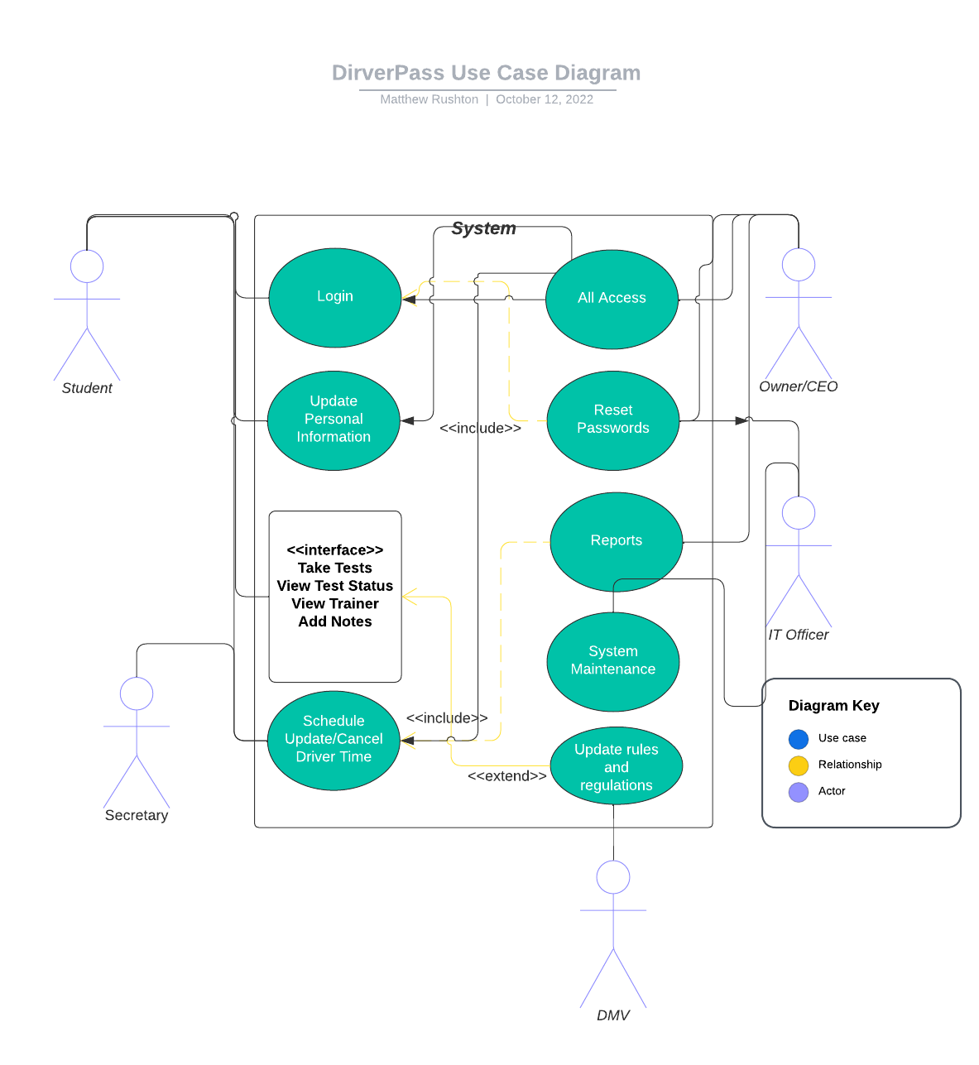
Use Case Diagram
Notes:
The Student will have several actions avaialable to them. They will be required to login. They can update their information at any time. The app will have a user interface so they can view their test progress, their notes, and see their instructors in one easy to access location. Users can schedule appointments with instructors, update these appointments and cancel. If they prefer, they can call the office and schedule with the secretary. The DMV will be a database for getting the latest rules and tests and the admins in the system will be allowed to update information and reset passwords as well as maintain the system
<number>

Slide 4
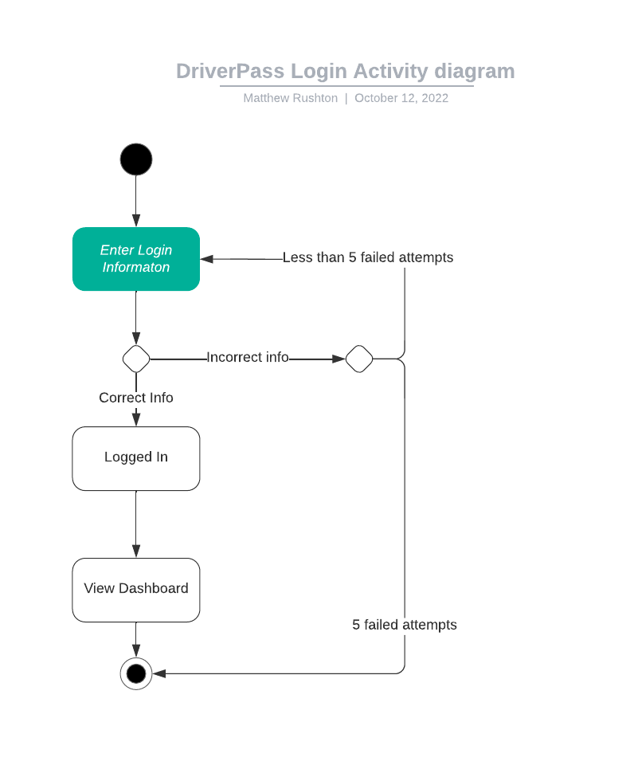
Activity Diagram
Notes:
The login steps for a student require a user name and password. If they provide incorrect information 5 times, the account will lock them out and a password reset will be required. They can use whatever password they wish, but the username must be unique. As soon as a successful login attempt is completed, the student is taken to their dashboard which is part of the user interface, where they can perform the various actions described earlier.
<number>

Slide 5
Login encryption uses the same encryption system used by the U.S. Government
Up to 5 failed login attempts, then users are locked out
Password resets use an email confirmation for verification and are required if account is locked due to failed login attempts
Security
Notes:
Encryption is important in dealing with personal information being transmitted across the internet. The government is involved in many things that can affect national security, so they rely on a very high standard for encryption. Because encryption is not difficult to implement, but for all practical purposes impossible to break, we used this standard to ensure the utmost privacy. Along with encryption, use of verified emails is another step toward keeping information secure. To keep “Brute Force” attacks, which are endless login attempts until something work, the 5 attempt limit keeps the account extra secure.
<number>

Slide 6
Capacity. Only 12 drivers and instructors are available to serve students
DMV information. Subject to DMV policy, our updates rely on the DMV updating their information. Delays at the DMV will cause delays in DMV updates within the application
Database. Space will eventually require upgrade, which is a financial constraint.
System Limitations
Notes:
Having limited staff means that a limit exists on how many appointments can be scheduled for drives. This limit can be decreased as time goes by and the need for more instructors can be within budge.
The DMV maintains their own database and drawing information from that relies on their information being updated. This limitation is dependent upon the efficacy in which the local office updates their information.
Finally, the database can only hold so much information. On the cloud this limit is only a financial one as cloud services are scalable. More space is more money, typically.
<number>

